Slide 1
Weill Cornell Medicine – November 2, 2018 The Basics of Estate Planning & Documents
Brian Zimmet, Esq.,
Daniel A. Timins, Esq., CFP®
Zimmet Law Group
477 Madison Avenue, Suite 240
New York, NY 10022
www.zimmetlaw.com
(212) 922-1330

Slide 2
Disclaimer
All information contained herein is for informational purposes only. It should not be considered legal advice. Please consult an attorney before taking any steps based on this information.
The information provided herein is subject to change on an annual basis or more frequently.
Any tax information provided herein is strictly incidental and not provided from a tax preparation professional.
Any references to investment gains are based on past results, and are not a guarantee as to the future.

Slide 3
What Are We Talking About Today?
Money
Saving Money on Health Care and Court Costs
Transferring Money / Wealth to Other People
Preserving Family Wealth

Slide 4
Legal Documents
Power of Attorney [“POA”]
Health Care Proxy [“HCP”]
Living Will [“LW”]
Last Will & Testament [“LWT”]
Trusts

Slide 5
Power of Attorney
A legal document
Naming another person
Who can make financial decisions for you
Including (sometimes) gifting your money to others
While you are alive
Your “Attorney-in-Fact” under your POA does NOT need to be a lawyer – it is usually a family member

Slide 6
Power of Attorney
Each state has their own POA (their “Statutory Form”)
Some financial companies have their own form (it is only good for working with that company)
Can allow your “Attorney-In-Fact” to:
Pay your bills / write checks
Change your investments
Buy or sell your stuff
Filing income taxes
Bringing lawsuits

Slide 7
Power of Attorney - Gifting
You may allow your agent to GIFT your money while you are alive…but you don’t have to
POSITIVES: Medicaid Planning, minimizing some taxes
NEGATIVES: Agent may dispossesses you of some (or most) of your money
When you DIE the POA is CANCELLED
At that point your WILL is the operative estate document

Slide 8
Power of Attorney: TIPS
If you have an aging family member, bring them with you to their bank / financial planner with the POA.
Easier to validate a POA when the principal is competent and present.
You do not need an original POA except when transferring real estate for the principal.
REMEMBER → ONLY appoint someone you TRUST: The POA can serve as a “Blank Check” – you are giving this person access to your finances; by law they are supposed to use the money for your benefit, but they can legally access your money and illegally run away with it.

Slide 9
Health Care Proxy
A legal document
That names an Agent (“Health Care Agent”)
To make health care decisions for you
And gives them access to your HIPAA information
Includes limitations on care
Includes limitations on organ donations
Allows or disallows your agent to discontinue life support

Slide 10
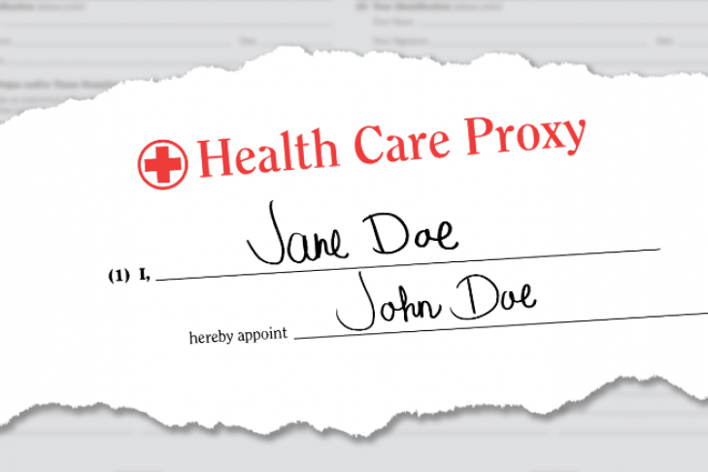
Health Care Proxy
May only be needed for a few hours.
Example: You are generally-anesthetized for a quick surgery.
May be effective for the rest of your life.
Example: You have a bad stroke / dementia / Parkinson’s and can never make a health decision again.

Slide 11
Living Will → “Pull The Plug”
States what you would like to happen to you if you cannot make your own health care decisions and:
1. You are in a terminal condition; or
2. You are permanently unconscious; or
3. You are conscious but have irreversible brain damage and will
never regain the ability to make decisions and express your wishes.
Referred to as "vegetative state.”

Slide 12
Living Will
Sample language:
I feel especially strongly about the following forms of treatment:
I do not want mechanical respiration.
I do not want tube feeding.
I do not want antibiotics.
I do not want cardiac resuscitation.
I do want maximum pain relief, even if such treatment hastens my death.
I direct that treatment be limited to measures to keep me comfortable and to relieve pain, including any pain that might occur by withholding or withdrawing treatment.

Slide 13
Why You NEED a Power of Attorney & Health Care Proxy
Many people (unmarried, no children, disinterested) can’t think of a trusted person, so they don’t do their living documents.
If you are incapacitated and have not named someone to make health or financial decisions for you, the Courts will appoint one.
Guardianship / Conservatorship

Slide 14
Gross Estate (Your Assets When You Die)
Non-Probate Estate: NOT Your Will
Property that we know who receives it when you die.
“Operation of Law”
“Testamentary Substitute”
Probate Estate: Your Will
Property passing by your Will only transfers money that “We don’t know where it goes without the Will.”

Slide 15
We Transfer Assets, NOT Income
INCOME
Not much control over it.
Income is typically on-going (Social Security, Pension).
Can only (sometimes) leave your income to one person: Your Spouse.
ASSETS
Complete control over our assets.
Capital Gains Taxes are usually lower than Income Taxes.
We can trade or give our existing stuff to other people, change its nature.
We are talking about assets here.

Slide 16
Transfers Outside of Your Will: Operation of Law
“We know who receives the property the moment you die.”
The only thing you need to collect the asset is an original Death Certificate.

Slide 17
LWT: What is NOT transferred
Wills do NOT transfer property that has successor ownership that is known at the moment of your death, I.e. anything with a named beneficiary.
Life Insurance
IRA, 401(k), pension plan, 403(b), TDA
Joint Property with Right of Survivorship including your house, bank accounts, brokerage accounts
Transfer on Death and In Trust For accounts, life estates
Trusts
Contracts (e.g. pre-nuptial, partnership)

Slide 18
Last Will & Testament [“LWT”]
An original written or typed legal document
Signed by you and witnessed by disinterested people
That states who receives assets still in your ownership after death
And names a legal representative (Executor) to wind-up your affairs
Plus, can name a preferred guardian for your minor children
That is submitted to Court that oversees the Probate process
At the time of your death
But only Probated if money or guardianship needs to be dealt with

Slide 19
LWT: What is transferred?
Wills ONLY transfer property you still own after you die → We don’t know who gets the property, so we must look at your Will.
A bank account, car or home solely owned by you
Personal property
Anything else NOT transferred by “operation of law”
Any property that names “My Estate” as beneficiary
→ NEVER, NEVER, EVER, NEVER name “My Estate” as your beneficiary!

Slide 20
My Wills is Being Probated: Who Must be Placed on Notice?
This varies state-by-state; in New York this is the order:
1. Spouse -100%
2. Spouse/Children -$50,000 + 50%/50%
3. Children -100% (then grandchildren)
4. Parents -100%
5. Siblings -100% (Nieces and Nephews)
6. Grandparents -100%
7. Aunts + Uncles -100%
8. Cousins -100%
9. The State

Slide 21
The State’s Priority Controls A Lot About Wills
Who gets what money if there is no Will
Who gets put on notice if there is a Will
Who has the best right to serve as Executor / Administrator
Who can legally contest the Will

Slide 22
Those Denied In the State's Will for You
Life Partners
Friends
Those people not in line in the priority list
Step-Children; non-adopted children
Pets
Organizations and Institutions
Business Partners
Specific Gifts to Specific People

Slide 23
Probate vs. Administration
Will
Legal Process: Probate
Responsible Party: Executor
Who gets what?: Your choice
No Will
Legal Process: Administration
Responsible Party: Administrator
Who gets what?: State default

Slide 24
What Does My Executor Do? An Executor “Steps into your shoes”
Delivers your Will to the Court
Collects your Probate assets
Pays funeral expenses
Pays creditors & taxes
Hires help (attorneys, accountants, movers)
Can get the Testator’s medical records
Can bring a lawsuit
Cleans out your closet
Gives Money to the Beneficiaries

Slide 25
Order of Who Gets Paid
Funeral Home & Burial Costs
Attorneys, Accountants & Court Fees
Executor Fees
Preferred Creditors (Government, mortgage)
Non-preferred Creditors (everyone else)
Beneficiaries in Will (or Administration)

Slide 26
Want something? Get it in writing!
If the “Testator” tells you one thing, but the Will says something else, the Will wins
Example: Mom tells you that you get her jewelry, the Will says your sister gets it → your sister gets the jewelry.
NO “Dead Man’s Rule” in New York

Slide 27
Trusts: What Are Trusts?
Written and signed legal documents
That name a creating, administering and beneficial party(ies)
Stating the terms by which the assets held by the document shall be administered
While avoiding court oversight
Which continues to exist after your passing
And only impacts property that is owned by the trust

Slide 28
Wills vs. Trusts
Wills | Trusts
Probate = Public | Trust Administration = Private
Burden of proof on Executor | Burden of proof on contesting party
Slow & more-expensive administration | Fast, minimal administrative costs
Requires minimal mental capacity | Requires greater mental capacity
Just need to execute to be effective | Need to execute AND FUND trust

Slide 29
Trusts: Who Are the Parties?
Creator / Settlor
> Creates the Trust
> Funds the Trust
Beneficiaries
> Entitled to the property under the terms of the Trust
Trustee
> Manages the trust property
> Follows the Terms of the Trust
> Entitled to a Commission

Slide 30
Why Revocable Trusts?
AFTER LIFE
Privacy
No Probate Fees
Faster Distribution
Flexibility on Distribution Terms

Slide 31
Revocable Trusts: Who Does What?
Creator
> YOU
Beneficiaries
> NOW: YOU until death
> LATER: Children, friends,
close family members, charity
Trustee
> NOW: YOU until disability or death
> LATER: Children, friends,
close family member

Slide 32
Trusts Help Avoid Beneficiary Creditor Claims and Personal Problems
Spendthrift Provision: If beneficiary has creditor issues (or divorce)
Substance Abuse Provision: If beneficiary has drug abuse issues
Marital Requirements: Limits beneficiary if they don’t sign a pre-nup or post-nup
Can leave money as multiple distributive times
Prior to 35, health and education
At 25 → ¼ of Trust
At 30 → ¼ of Trust
At 35 → Rest of Trust

Slide 33
Why Irrevocable Trusts?
There are ONLY 3 reasons to have an irrevocable trust:
Creditor Protection for YOU
For Who: If you get sued often (Construction, OBGYN)
Reduce Estate Taxes
For Who: The wealthy
Procure Government Benefits
For Who: The poor, sick and disabled
You MUST give up some control to get these benefits (I.e. trust can’t be changed AND you can’t be both Trustee & Beneficiary)

Slide 34
Irrevocable Trusts: Who Does What?
Creator
> YOU
Beneficiaries
> Anyone OTHER than the Trustee
Trustee
> Anyone OTHER than
Beneficiaries

Slide 35
Funding Trusts
MUST name the Trust as a Current Owner or Future Beneficiary
Current Assets → Name Trust a Current Owner
Bank / Brokerage Accounts
Real Estate
Business Interests
Future Assets → Change Beneficiary Form to Trust
Life Insurance
Retirement Plans

Slide 36
Thank You!!!
Brian Zimmet, Esq.
Daniel A. Timins, Esq., CFP®
Zimmet Law Group
477 Madison Avenue, Suite 240
New York, NY 10022
www.zimmetlaw.com
(212) 922-1330

